Slide 1
HTTP JSON API Node.js
Time Server
- Presented by:
Xin Wen
- 2024 Spring

Slide 2
Table of Contect
Introduction
Installation of Node.js on Ubuntu
Study TimeServer
Study JSON
Study HTTP JSON API Server
Modify HTTP JSON API Server

Slide 3
Introduction
Node.js Exploration on Ubuntu:
Delved into Node.js on the Ubuntu platform for robust server-side development.
Time Server Concepts:
Explored Time Server concepts, understanding how to provide date and time information over the network.
JSON Essentials:
Gained a solid understanding of JSON (JavaScript Object Notation) essentials for effective data interchange and storage.
HTTP JSON API Servers:
Studied the concepts and implementation of HTTP JSON API Servers, a crucial aspect of modern web development.
API Server Enhancement:
Elevated skills by hands-on experience, enhancing an API Server to cater to specific client requests.
Concise Journey in Web Development:
Embarked on a concise journey through key web development elements, focusing on practical skills and real-world applications.

Slide 4
Installation of Node.js on Ubuntu
Setup Ubuntu(link)
Enable the NodeSource repository by running the following curl:
For node.js version 20.x
$ curl -sL https://deb.nodesource.com/setup_20.x | sudo -E bash -
Install Node.js and npm
# sudo apt install nodejs
sudo apt-get install -y nodejs
Verify the Node,js and np, installed successfully(link)
$ node --version
$ npm --version

Slide 5
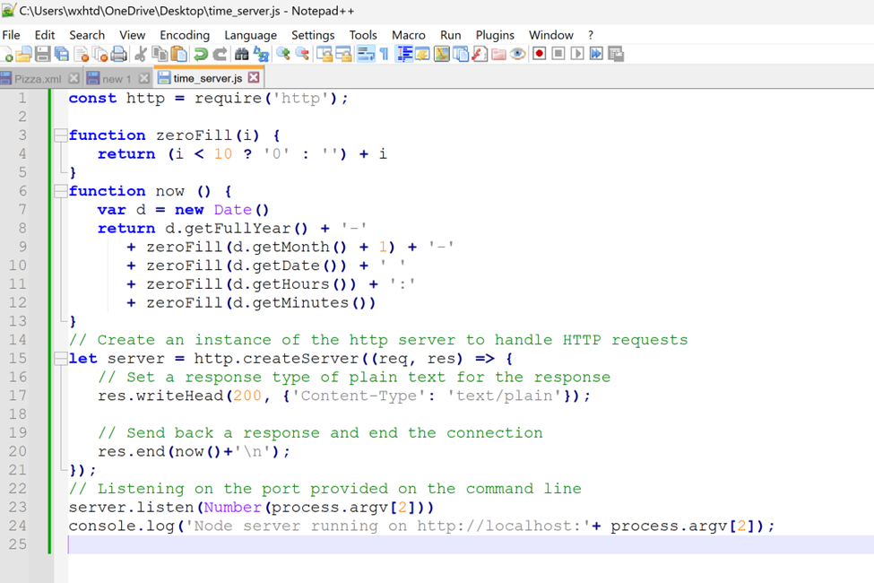
Study Time Server
Question: Create a Node.js TCP time server that listens on a specified port. Upon connection, send the current date and time in the format "YYYY-MM-DD hh:mm", ensuring zero-filled month, day, hour, and minute to 2 digits, followed by a newline character.
Step1:Open nodepad++ to create the time_server.js file.

Slide 6
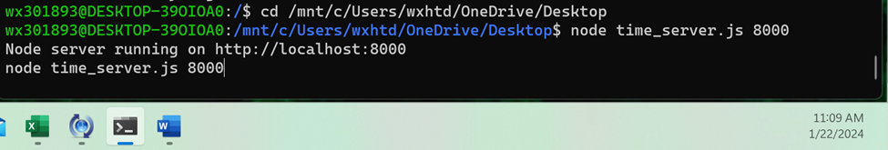
Study Time Server
Step2:
Open Ubuntu terminal and change the directory to where we stored the time_server.js file:
cd /mnt/c/Users/wxhtd/OneDrive/Desktop
Then enter :node time_server.js 8000

Slide 7
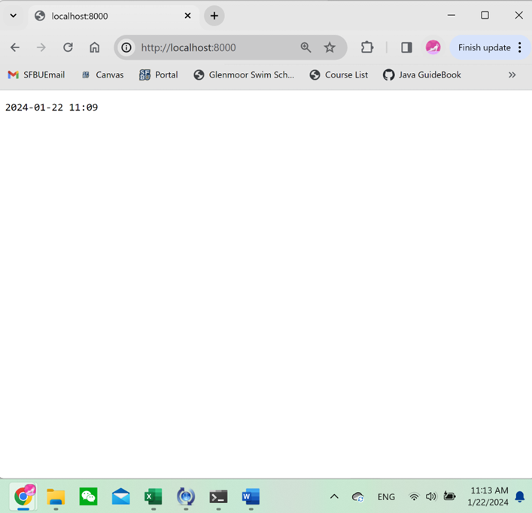
Study Time Server
Step3:
Open the browser and go to http://localhost:8000, you could see a page with the current time like this:

Slide 8
Study JSON
Definition: JSON (JavaScript Object Notation) is a lightweight data interchange format.
Structure: Represents data using key-value pairs, enclosed in curly braces {}.
Data Types: Supports basic types like strings, numbers, booleans, arrays, objects, and null.
Readability: Human-readable and easy to write, commonly used for configuration files.
Usage: Widely used in web development for AJAX requests, API responses, and data interchange.

Slide 9
Study JSON
Difference between JSON and XML:
JSON:
Lightweight data interchange format.
Simple and compact syntax with key-value pairs, arrays, and nested objects.
Easier for humans to read and write; less verbose.
Supports basic data types (strings, numbers, booleans, arrays, and objects).
Faster parsing and easier integration with JavaScript.
Does not support namespaces.
XML:
Markup language for storing and transporting data.
Uses verbose tag-based syntax with opening and closing tags.
More verbose and can be less readable for humans.
Supports a wide range of data types, with user-defined types through DTD or XML Schemas.
Parsing can be more complex, often requiring specialized parsers.
Supports namespaces to avoid naming conflicts.

Slide 10
Study HTTP JSON API Server
Question:
Create an HTTP server in Node.js that responds to a GET request at '/api/parsetime'. The request should include a 'iso' query parameter with an ISO-formatted time. The server sends a JSON response with 'hour', 'minute', and 'second'. Additionally, implement '/api/unixtime', providing UNIX epoch time. The server listens on a specified port.

Slide 11
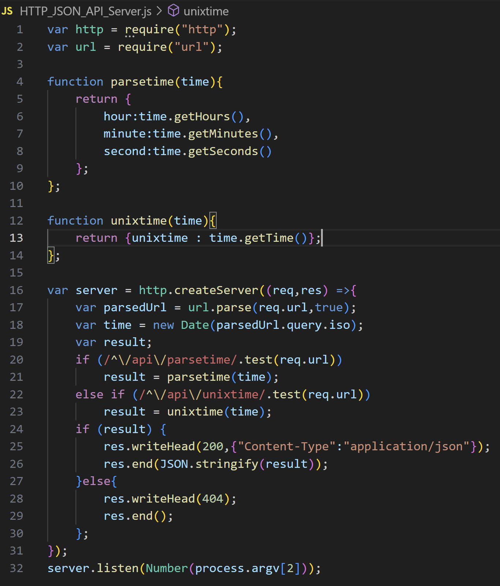
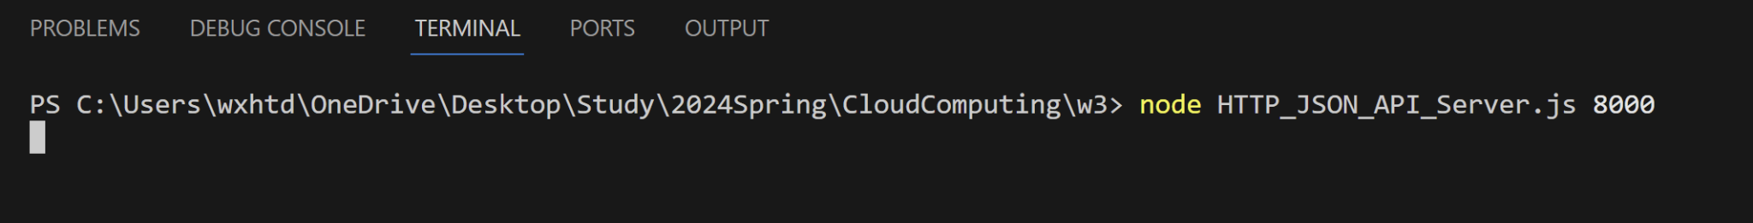
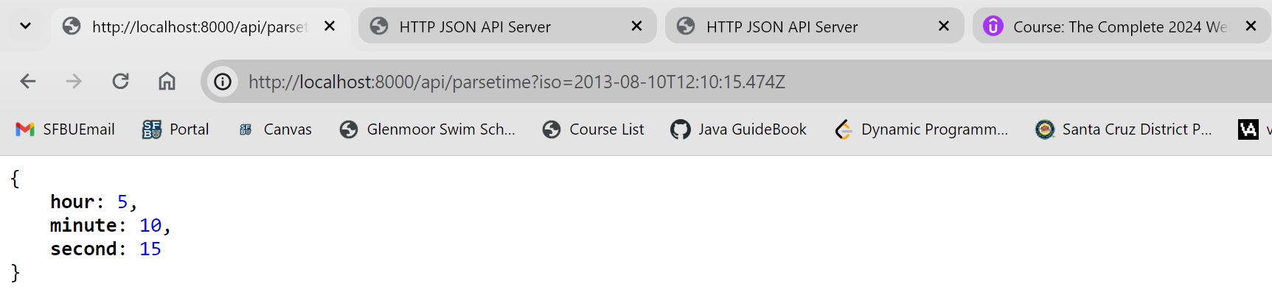
Study HTTP JSON API Server

Slide 12
Modify HTTP JSON API Server
Question:
Modify HTTP JSON API Server to support this request from the client side:
http://localhost:8000/api/currenttime
The browser displays
{"year":2021,"month":09,"date":24,"hour":16,"minute":09}

Slide 13
Modify HTTP JSON API Server
Modification:
Add a function called zeroFill to fill all the numbers under 10 into 2 digits.
Use the Date() function to parse the year, month and day.

Slide 14
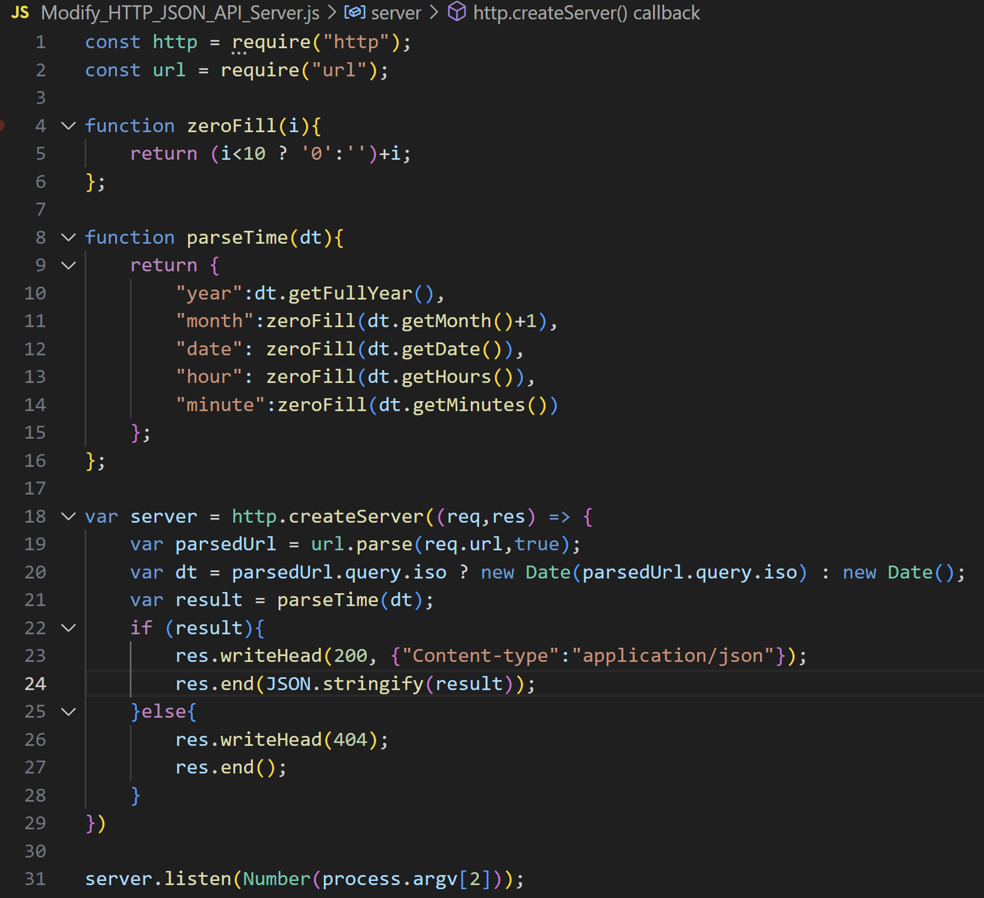
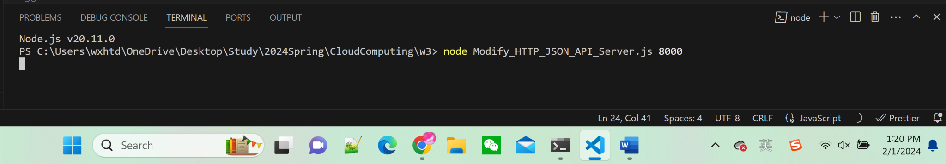
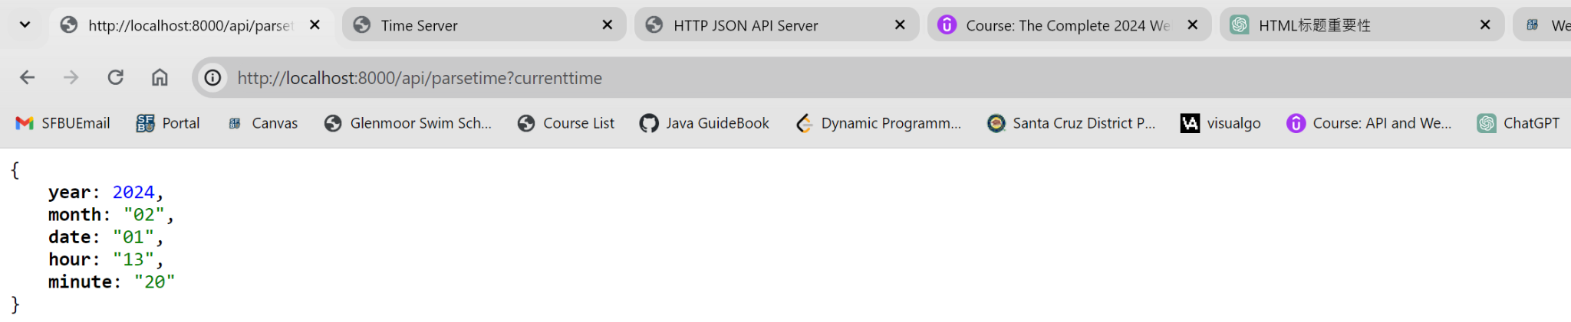
Modify HTTP JSON API Server

Slide 15
Conclusion
Node.js Installation: Acquired foundational knowledge in installing Node.js, a runtime environment for server-side JavaScript.
Time Server Functionality: Developed understanding and practical skills in implementing a Time Server using Node.js, providing date and time information over the network.
JSON Usage: Gained proficiency in working with JSON (JavaScript Object Notation) for data interchange and storage.
HTTP JSON APIs Development: Developed practical experience in creating HTTP JSON APIs, enhancing skills in server-side JavaScript and web service development.
API Server Modification: Demonstrated the ability to modify API servers, showcasing expertise in adapting and extending server functionalities.

